Slide 1
Interledger and Mojaloop
Briana Marbury, Executive Director
Interledger Foundation

Slide 2


Why Interledger?
Stefan Thomas, Co-Founder of the Interledger Protocol
Evan Schwartz, Co-Founder of the Interledger Protocol

Slide 3
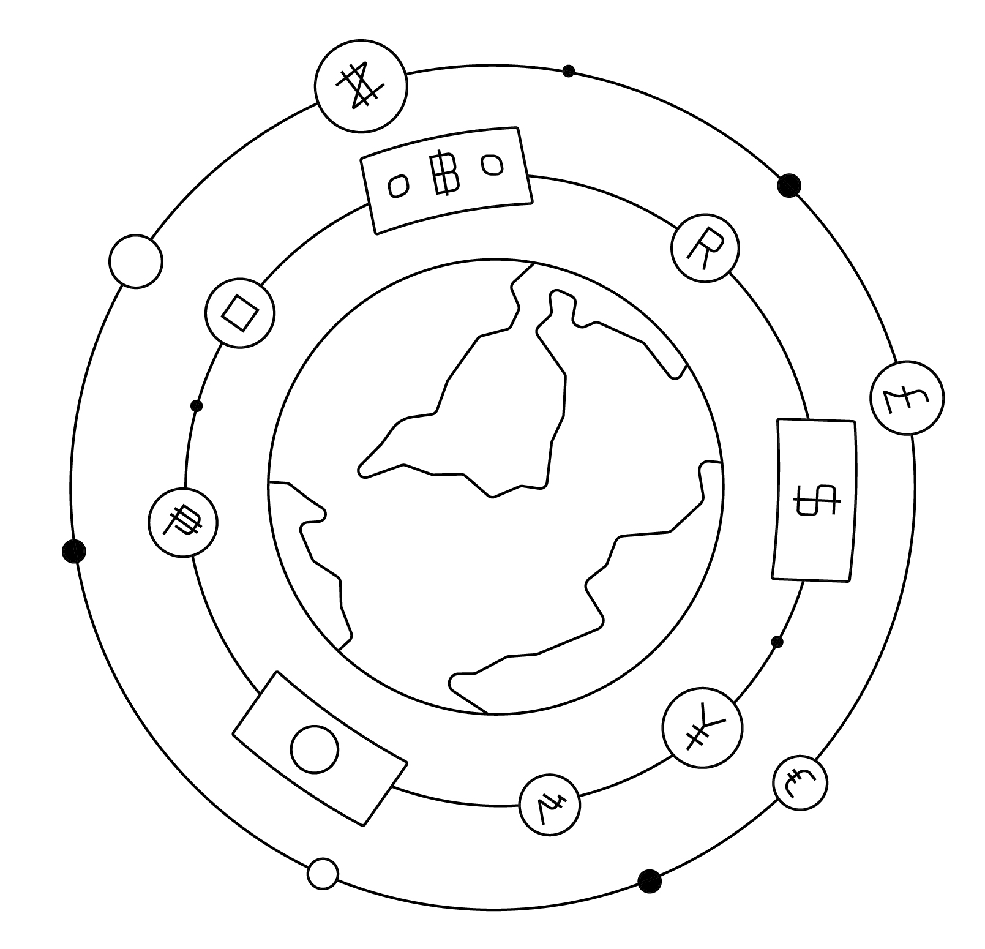
What is Interledger?
The Interledger Protocol is an agnostic way to send payments across the internet.

Slide 4


Interledger Basics
Inspired by the Internet
Neutral
Interoperable
Secure

Slide 5
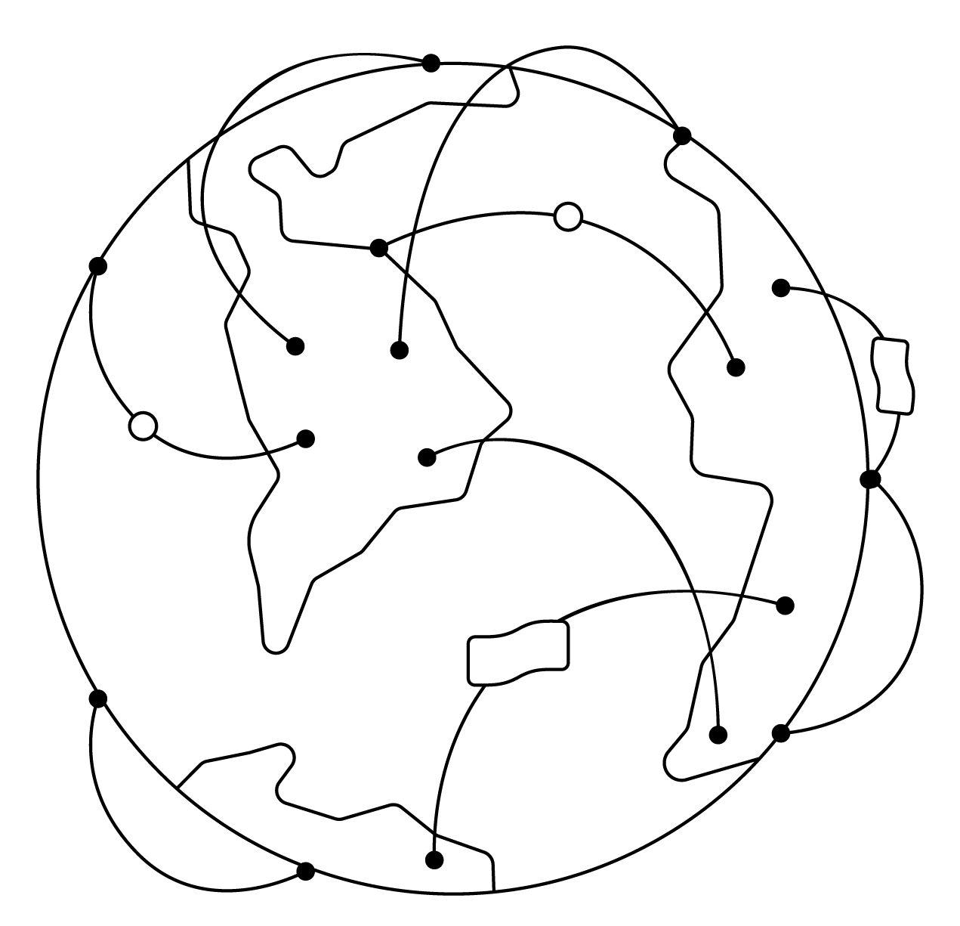
5 Layers of Interledger
Application
Transport
Interledger
Link
Ledger

Slide 6







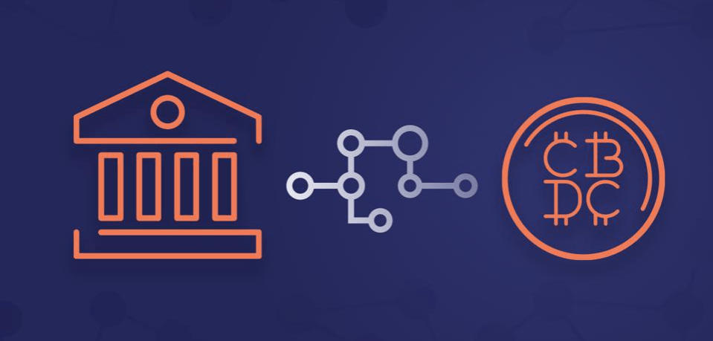
Use Cases
Web Monetization
Digital Wallets
Interoperability

Slide 7
5 Layers of Interledger
Mojaloop
Application
Transport
Interledger
Link
Ledger

Slide 8


Slide 9

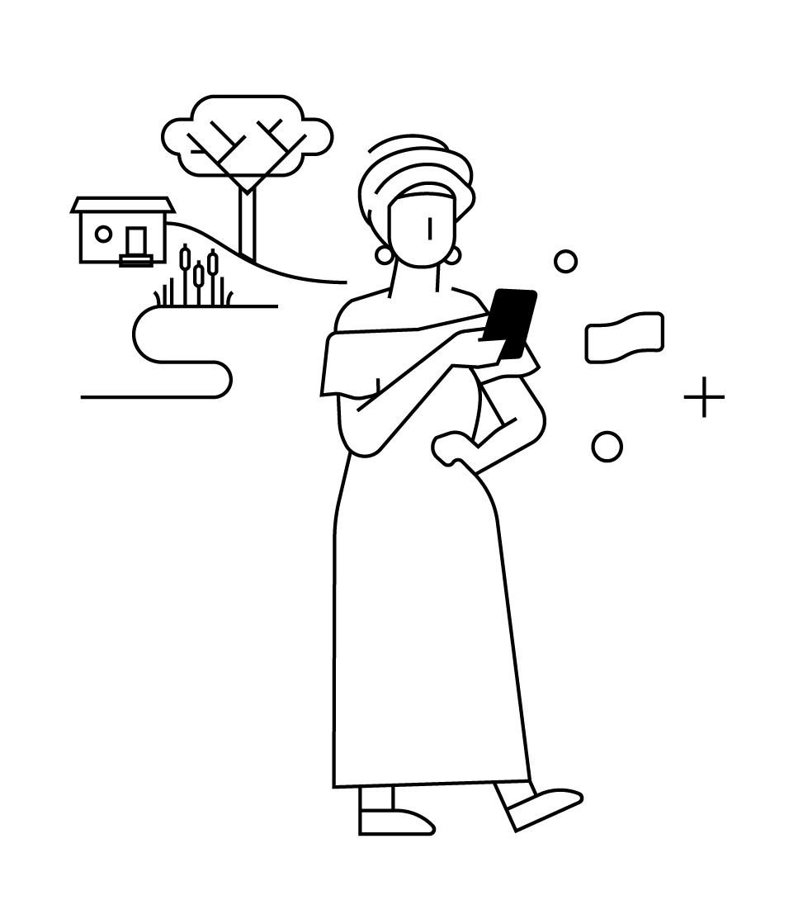

Interledger Foundation
Connecters of a Powerful Community of Web Advocates and Leaders
Stewards of ILP Technology and Standards Work that Advances the Open Payments Ecosystem
Promoters of Financial Inclusion and Innovative Solutions for Connecting Humanity

Slide 10

Programs

